Slide 1
Mobile App for Direct Market Access for Farmers
PIP4004 Capstone Project
Review-03
Batch Number: CIT-G06
Name | Roll Number
Sanjana.R | 20211CIT0043
Lingamdhinne Akanksha | 20211CIT0047
Koyi Mithun | 20211CIT0055
Narati Teja | 20211CIT0180
CH Jaya Prakash | 20211CIT0022
Under the Supervision of,
Dr. Sharmasth Vali Y
Associate Professor
School of Computer Science and Engineering
Presidency University
Name of the HoD: Dr. Anandaraj S P
Name of the Program Project Coordinator: Dr. Sharmasth Vali Y
Name of the School Project Coordinators: Dr. Sampath A K / Dr. Abdul Khadar A
/ Mr. Md Ziaur Rahman

Slide 2
Content
Problem Statement
Literature Review
Proposed Method
Model Architecture
Hardware and Software Requirements
Objectives
Methodology
Flow of Project
Timeline of the Project
References

Slide 3
Problem Statement Number:
Organization:
Category (Software/Hardware/Both): Software
Problem Description:Traditional agricultural marketplaces often suffer from a lack of transparency and inefficient payment processes. Farmers are often isolated from direct market access, and consumers have limited opportunities to purchase fresh products directly from the source. This project addresses these gaps by creating a platform that connects farmers directly with consumers, ensuring transparency in product quality and prices, along with efficient payment processing.
Difficulty Level: Ministry of Agriculture and Farmers Welfare

Slide 4
Introduction
Agriculture’s Importance: Agriculture remains the backbone of many economies and rural livelihoods.
Current Challenges: Farmers face limited market access, low profitability, and inefficient sales processes.
Project Focus: "Uplifting the Farmer through a Connected Ecosystem" aims to bridge these gaps.
Direct Marketplace: Enables farmers to sell products directly to consumers, eliminating middlemen.
User-Friendly Platform: Features include:
UPI-based secure payments
Real-time inventory management
Profile handling for both farmers and consumers
Government Scheme Access: Farmers are informed and connected to relevant schemes via the platform.
Promoting Transparency: Ensures clear pricing, trusted sellers, and real-time product updates.

Slide 5
LITERATURE SURVEY
Year | Author(s) | Title | Outcome
2018 | Pranav Shriram; Sunil Mhamane | Android App to Connect Farmers to Retailers and Food Processing Industry | Developed a mobile app to help farmers sell their products directly to consumers and industries. The app offers a user-friendly interface, location-based filters, and supports native language to enhance usability.
2022 | L.A. Imalka; K.G.A. Gunawardana; K.M.S.K. Kodithuwakku; H.K.E. Arachchi; S.M.B. Harshanath | Farming Through Technology Driven Solutions For Agriculture Industry | Ceylon E-Agro app for maize cultivation provides AI-based real-time solutions to pest control, price prediction, and IoT-based smart farming features for soil moisture maintenance and quality management.
2021 | R. Ranjana; T. Subha; Pravin Kumar P; Sneka L; Varsha S; Jothishree N | Integrated App for Farmers - Agreliance | Integrated app provides farmers with mental health services, crop consultations, telehealth, and retail options to sell produce online, especially helpful during the COVID-19 pandemic for economic and mental support.
2019 | Niket Chauhan; M. Krishnakanth; G. Praneeth Kumar; Prerna Jotwani; Utkarsh Tandon | Crop Shop – An application to maximize profit for farmers | Mobile app connects farmers directly with retailers, bypassing middlemen. The platform reduces the usual 70% profit taken by intermediaries, providing farmers with higher profit margins and consumers with lower-priced products.

Slide 6
Proposed Method
The proposed system integrates a unified platform for farmers, users, and administrators. Users can browse and purchase products while completing payments through UPI-based gateways. Farmers can manage inventory, update product listings, and receive payments directly into their accounts. Administrators will onboard trusted farmers, upload helpful schemes, and manage the platform's ecosystem.

Slide 7
Advantages of Proposed Method:
A cohesive system for purchasing agricultural products directly from farmers.
Payments are processed securely through UPI-like gateways, reducing delays.
Farmers can easily add and update their products.
Admins can upload schemes beneficial to farmers, ensuring they are accessible.
Future updates will allow for vehicle and land renting, as well as fertilizer management.

Slide 8
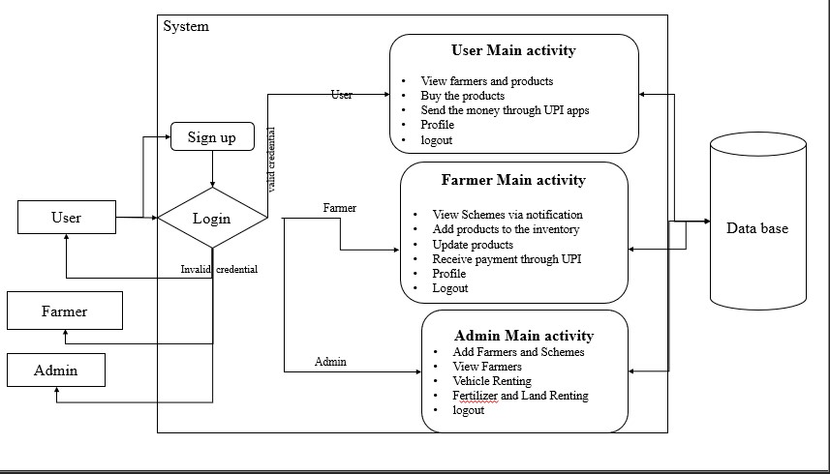
Model Architecture:

Slide 9
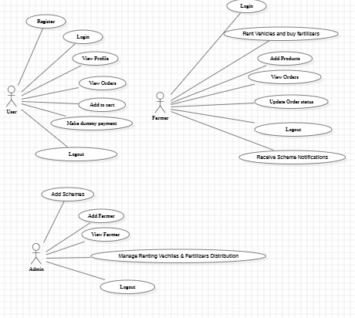
UML DIAGRAM
Figure: Use Case Diagram

Slide 10
HARDWARE & SOFTWARE REQUIREMENTS
SOFTWARE REQUIREMENTS:
Operating System - Windows 10
JDK - Java(kotlin)
SDK - Android
IDE - Android studio
Database - my SQL

Slide 11
Objective of Project
The objective is to develop an application that connects consumers directly with farmers, offering a seamless and secure payment gateway, profile management, and inventory system. The platform will allow users to view and purchase products from verified farmers. Provide farmers with tools to manage their product listings, receive payments, and stay informed about government schemes. Enable administrators to maintain trust within the system by onboarding verified farmers and providing them access to beneficial schemes.
.

Slide 12
Methodology
The agricultural sector has long faced challenges with transparency, efficiency, and market accessibility, leaving farmers without direct avenues to reach consumers and maximize their profits. The motivation behind this project is to empower farmers by bridging the gap between them and consumers, creating an ecosystem that ensures fairness, trust, and accessibility. By integrating technology with agriculture, this platform provides farmers with tools to manage their products, streamline payments, and access beneficial schemes. This will not only uplift farmers' livelihoods but also foster a sustainable farm-to-consumer relationship, enhancing the overall agricultural economy.

Slide 13
Existing method
Disadvantages in Existing method:
Current platforms in agriculture-based commerce either offer limited direct interaction between farmers and consumers or are complicated by lengthy payment processes.
Farmers often face challenges in listing their products and managing payments. Additionally, government schemes that benefit farmers are often underutilized due to a lack of awareness and access.
Fragmented processes lead to inefficiencies in connecting farmers with consumers.
Lack of seamless payment solutions hinders transaction completion.
Limited visibility of government schemes results in missed opportunities for farmers.

Slide 14
Conclusion
Comprehensive Solution: Addresses key challenges faced by farmers in accessing markets and managing transactions.
Direct Connectivity: Bridges the gap between farmers and consumers, eliminating the need for intermediaries.
Enhanced Transparency: Promotes trust through clear product information and pricing.
Efficient Payments: Integrates secure and fast payment systems, ensuring timely transactions for farmers.
Trustworthy Ecosystem: Admin verification and scheme uploads help maintain platform integrity.
Sustainable Agriculture: Encourages long-term, eco-friendly practices for improved farmer livelihoods.
Mutual Benefits: Ensures value for both farmers (increased income, access) and consumers (fresh produce, fair prices).

Slide 15
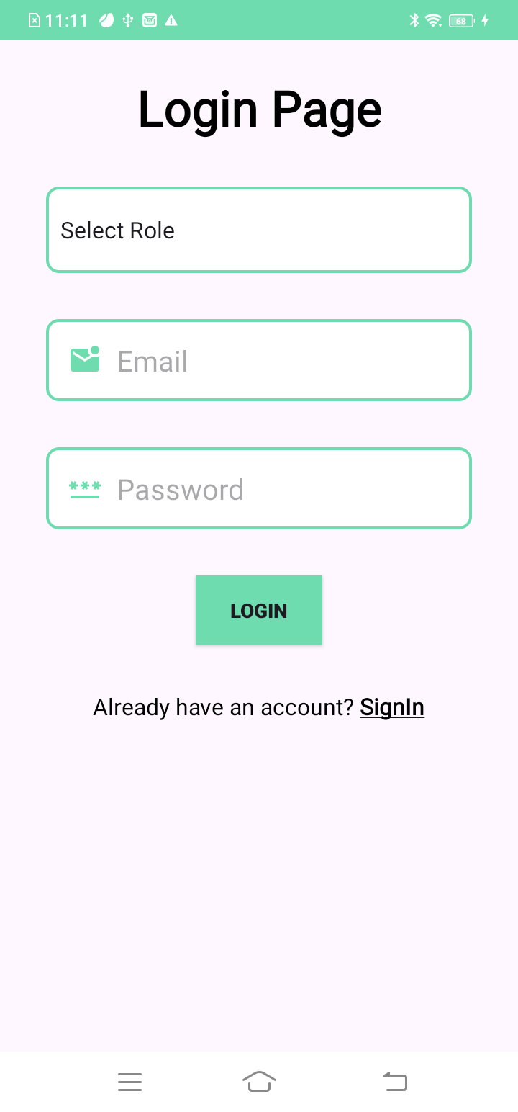
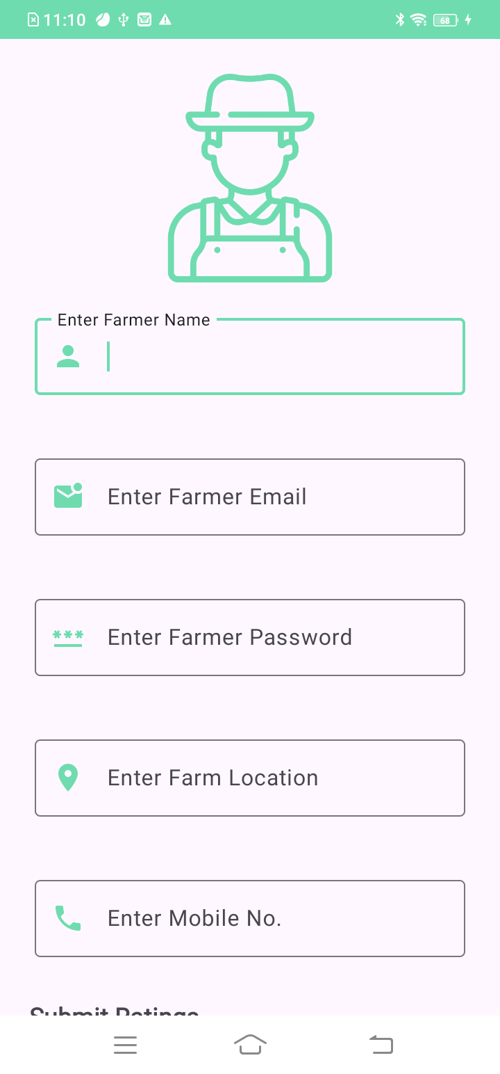
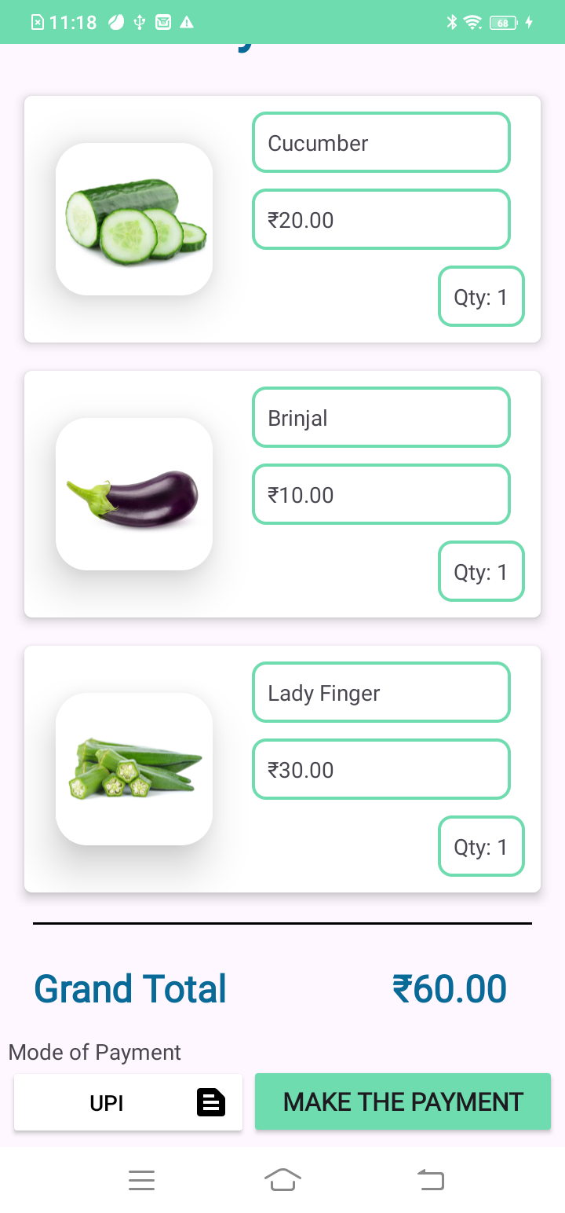
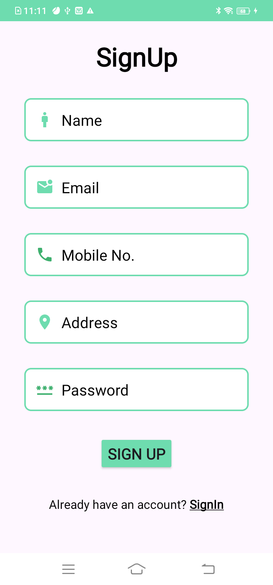
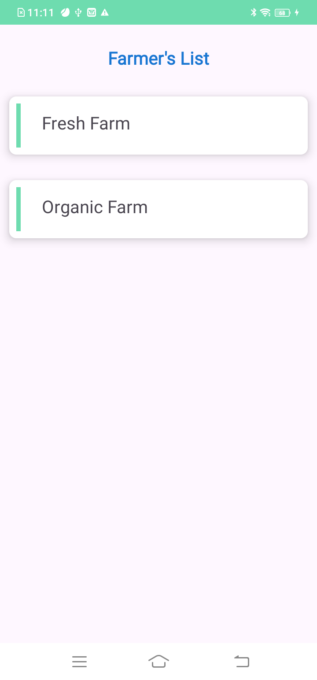
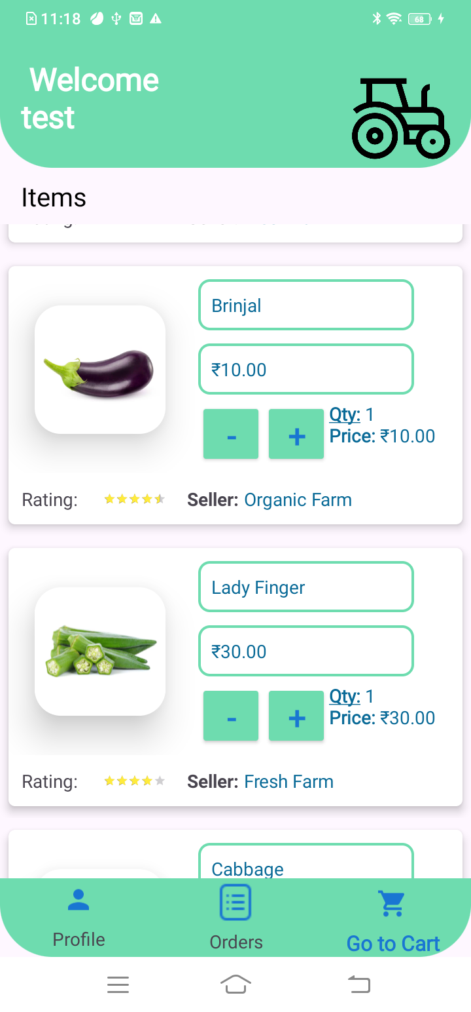
OUTPUT SCREENS

Slide 16
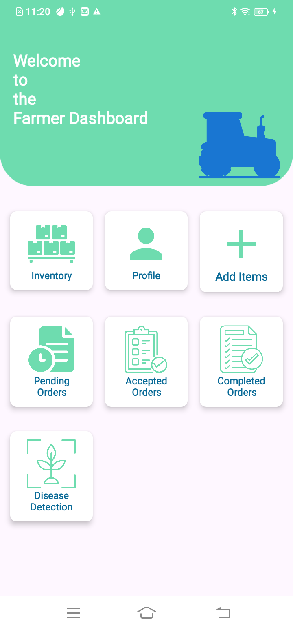
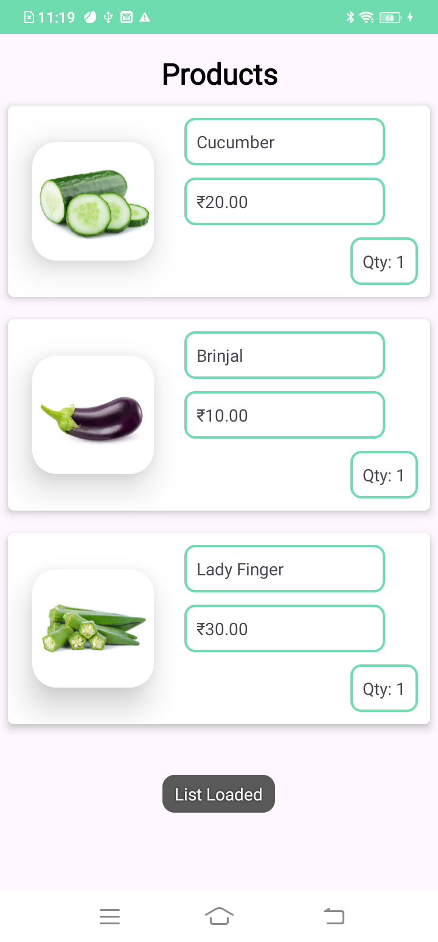
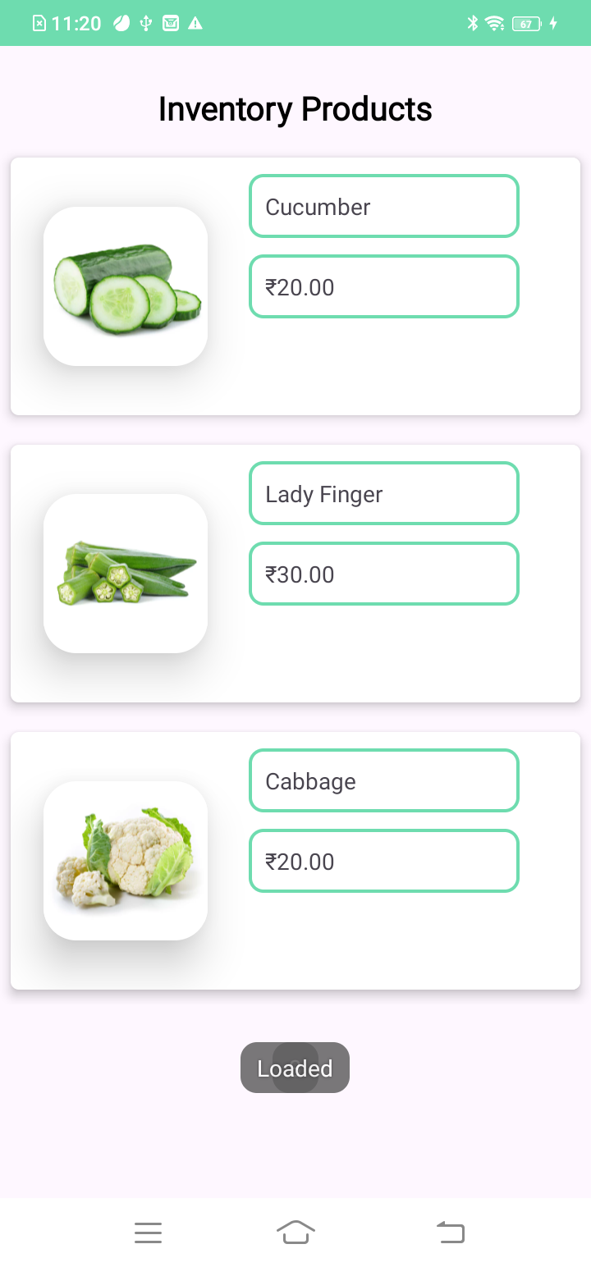
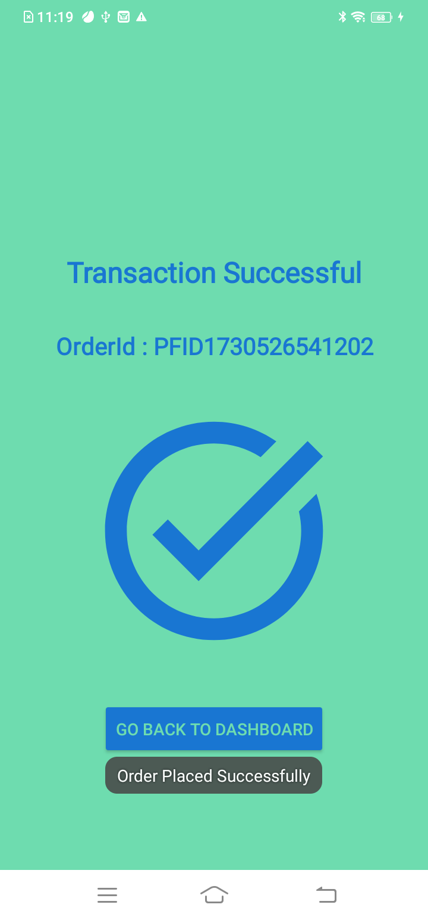
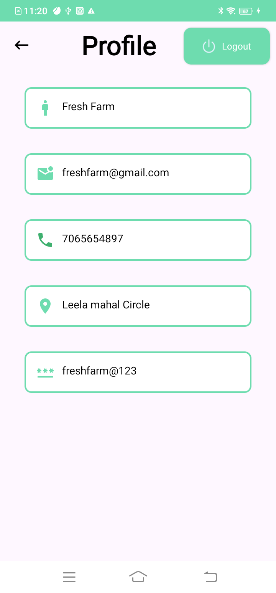
OUTPUT SCREENS

Slide 17
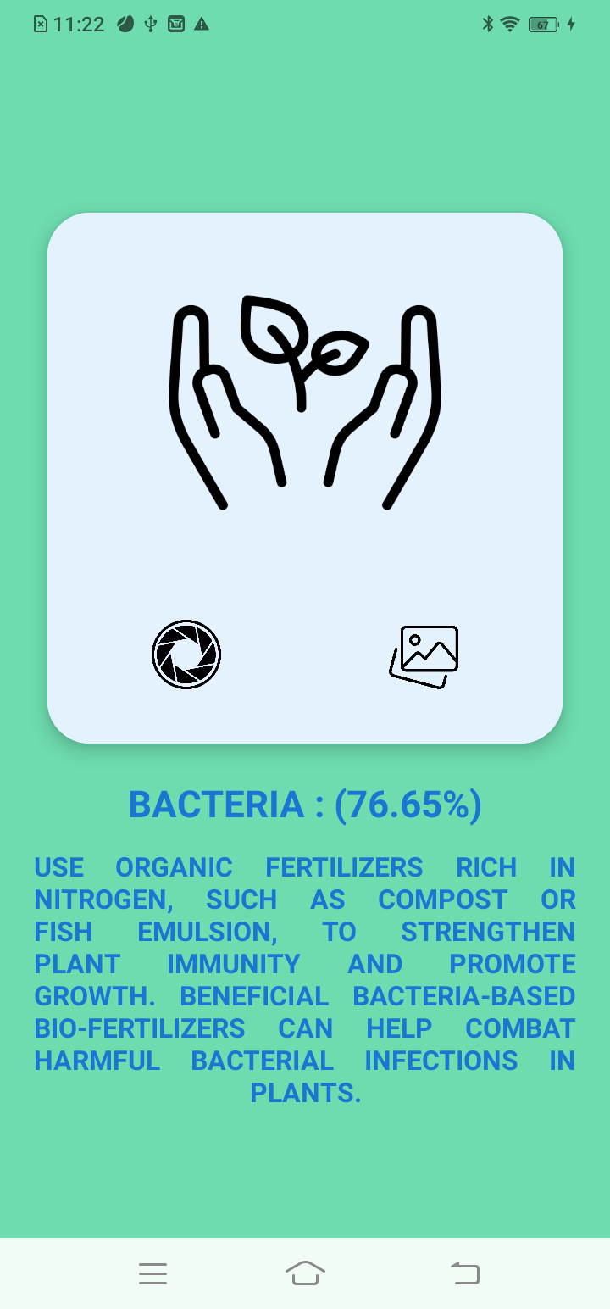
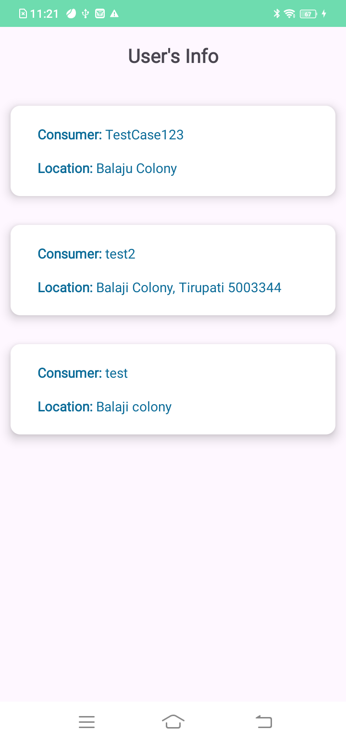
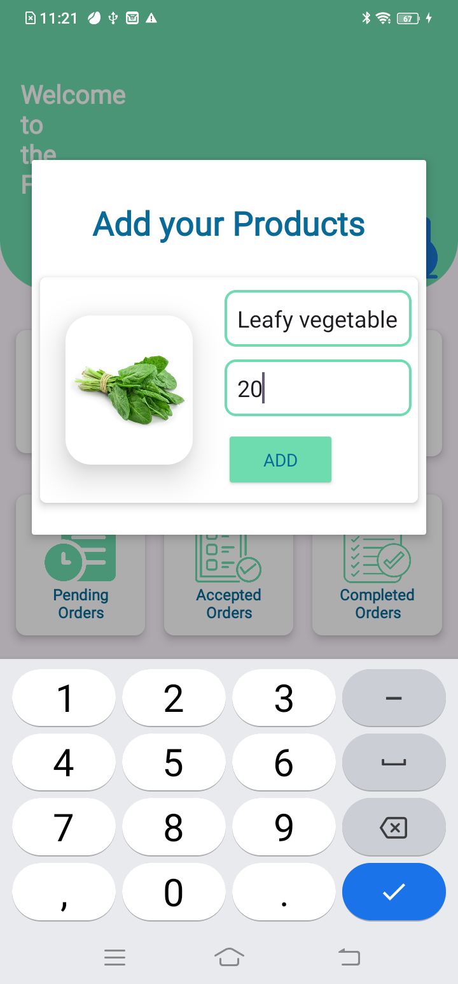
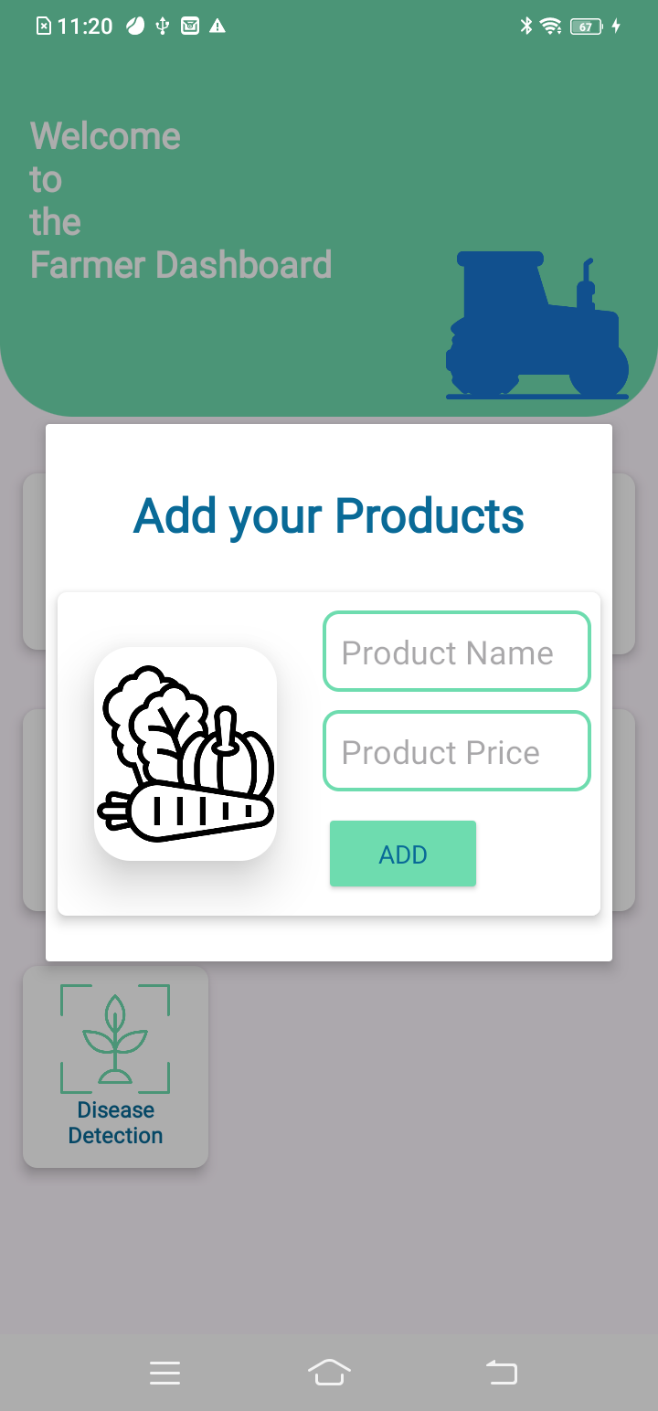
OUTPUT SCREENS

Slide 18
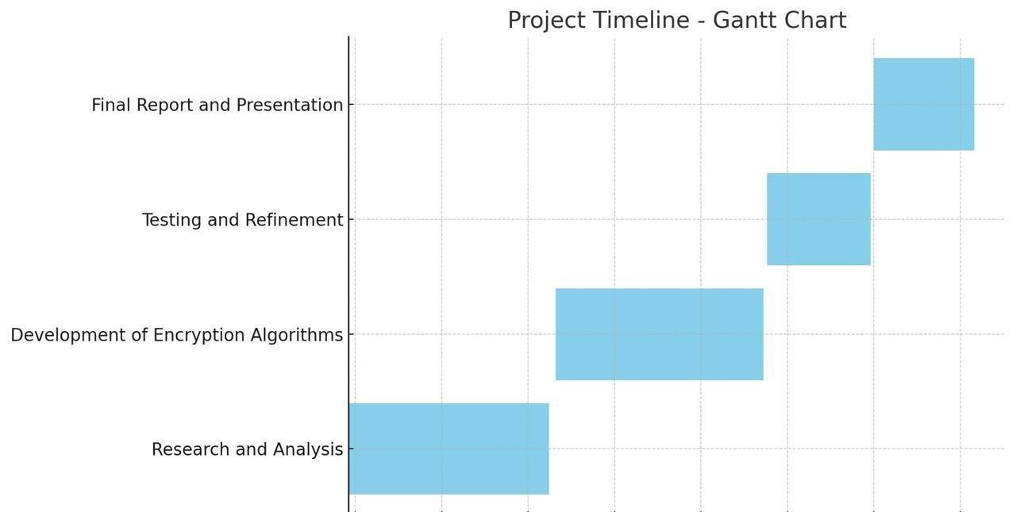
Timeline of the Project
21-Apr-2025 to 26 -Apr-2025
17-Mar-2025 to 21-Mar-2025
18-Feb-2025 to 21-Feb-2025
29-Jan-2025 to 31-Jan-2025

Slide 19
References
L.A. Imalka; K.G.A. Gunawardana; K.M.S.K. Kodithuwakku; H.K.E. Arachchi; S.M.B. Harshanath | Farming Through Technology Driven Solutions For Agriculture Industry Ceylon E-Agro mobile application-find technology based solutions for agricultural problems | 16-18 September 2022
R. Ranjana; T. Subha; Pravin Kumar P; Sneka L; Varsha S; Jothishree N | Integrated App for Farmers - Agreliance | 16-17 December 2021
Niket Chauhan; M. Krishnakanth; G. Praneeth Kumar; Prerna Jotwani; Utkarsh Tandon | Crop Shop – An application to maximize profit for farmers | 30-31 March 2019
Aina Marie Joseph; Nurfauza Jali; Amelia Jati Robert Jupit; Suriati Khartini Jali | eMarket for Local Farmers | 23-25 November 2021
Pranav Shriram; Sunil Mhamane | Android App to Connect Farmers to Retailers and Food Processing Industry | 15-16 November 2018

Slide 20


Slide 21
